Slide 1


BIKE SALES ANALYSIS PROJECT REPORT
By
Dharmesh Rohit
Data Analyst

Slide 2
Bike Sales analysis Project
Project Repository
Data Warehouse Project Repository
Datasets

Slide 3
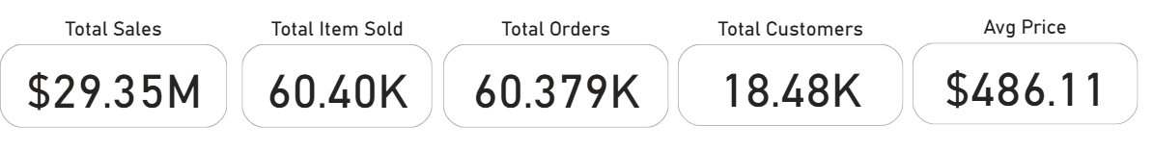
Exploratory Data Analysis
Date range of the data: "2010-12-29“ to "2014-01-28“
Key Performance Indicators (KPIs)
Key Insights:
The business generated $29.35 million in revenue, with over 60,420 products sold.
A total of 60,379 transactions were recorded, placed by approximately 18,484 unique customers.
The average price per item across all sales is $486.11, indicating a mid-to-premium product range.

Slide 4
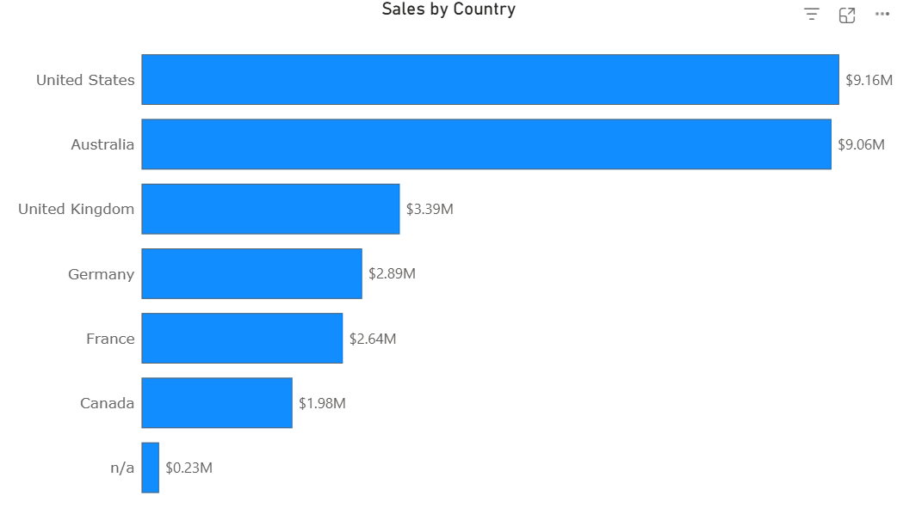
Geographic Sales Distribution:
The United States ($9.16M) and Australia ($9.06M) are the top-performing markets, together contributing over 60% of total sales.
The United Kingdom ($3.39M), Germany ($2.89M), and France ($2.64M) show strong mid-tier performance.
Canada ($1.98M) presents potential for growth.
Around $230K worth of sales have no country associated, indicating data quality issues or unclassified records.
Recommendation: Prioritize marketing efforts in the US and Australia, and investigate the “n/a” country data for cleanup.

Slide 5
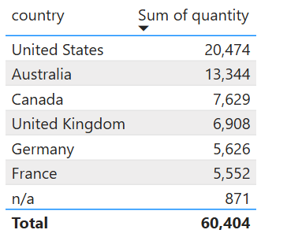
Items Sold by Country
United States leads not only in revenue but also in volume, with 20,474 items sold.
Australia follows with 13,344 units, indicating a strong market presence.
Interestingly, Canada ranks 3rd in volume (7,629 items) but 6th in revenue — suggesting lower-priced items or high discount rates.
Germany, France, and the UK all have similar unit volumes between 5.5K–6.9K, reflecting consistent demand across Europe.
The “n/a” category again highlights data needing attention — 871 units lack country info.

Slide 6
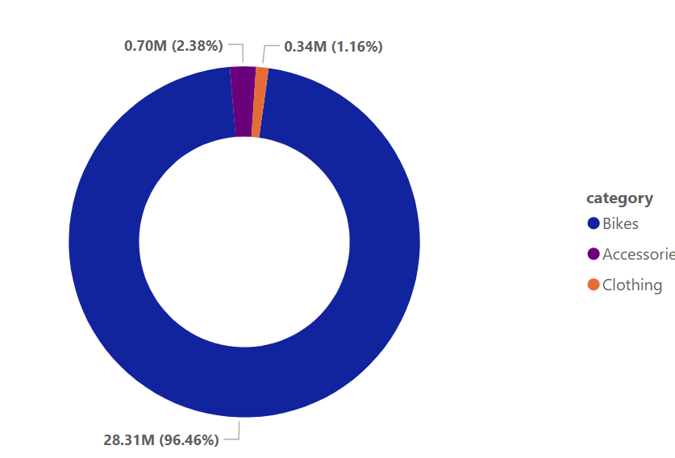
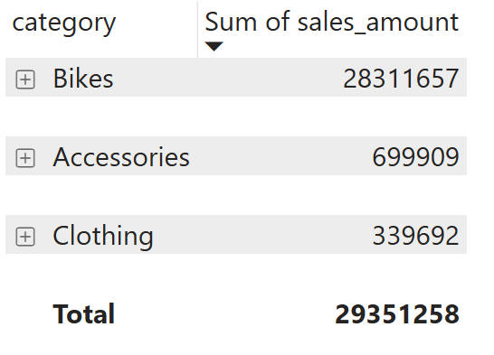
Sales by Category & Subcategory
Bikes are the clear leader, accounting for $28.31M in revenue. 96.46% of total sales.
Accessories and Clothing contribute $699.9K and $339.7K, respectively, suggesting potential for growth through bundling or promotions.

Slide 7
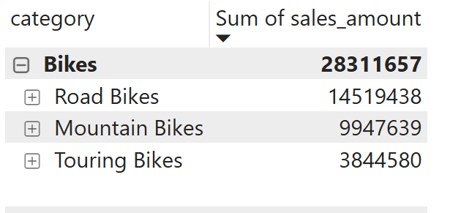
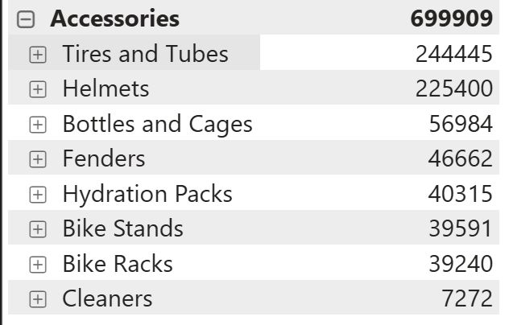
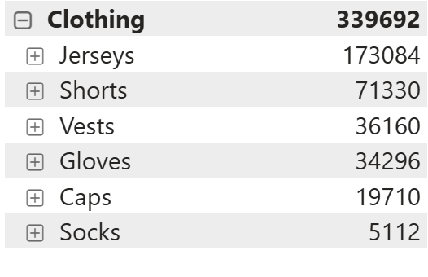
Top Performing Subcategories:
Within Bikes, the best sellers are:
Road Bikes – $14.52M
Mountain Bikes – $9.95M
Touring Bikes – $3.84M
Within Accessories:
Tires and Tubes – $244.4K
Helmets – $225.4K
Others (e.g., Hydration Packs, Bike Stands) are below $60K
Within Clothing:
Jerseys dominate with $173K
Followed by Shorts ($71K) and Vests/Gloves (~$35K each)

Slide 8
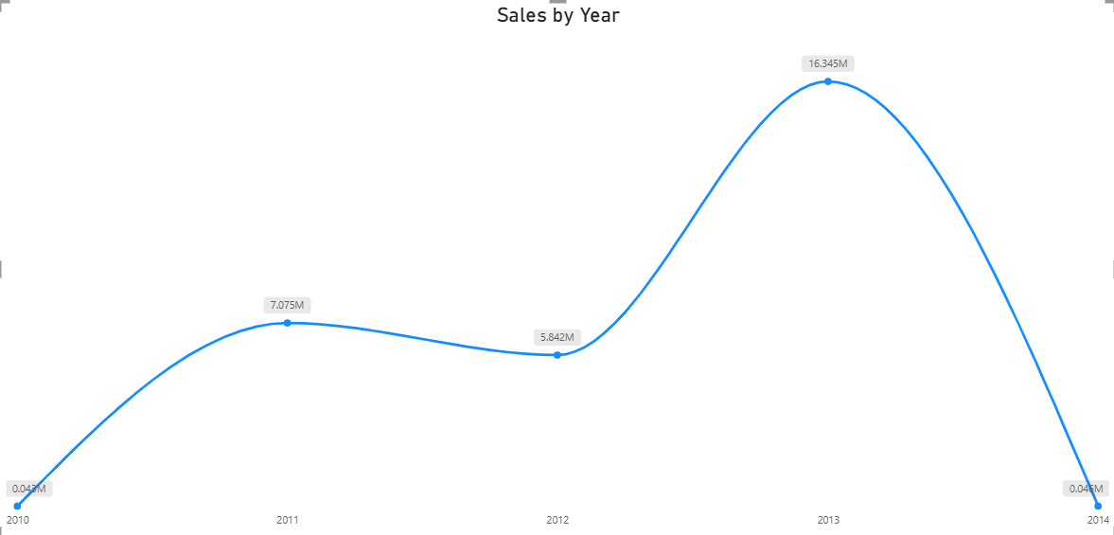
Sales Trend by Year (2010–2014)
Sales began in 2010 at $43K, marking the start of operations.
In 2011, sales jumped to $7.08M, showing strong early growth.
In 2012, there was a slight dip to $5.84M, possibly due to market saturation or seasonal changes.
A major spike occurred in 2013, reaching $16.35M, the highest on record — more than 2.5x growth from 2012.
2014 shows only $45K in sales, indicating the year was either incomplete in the data or represents a shutdown/transition period.

Slide 9
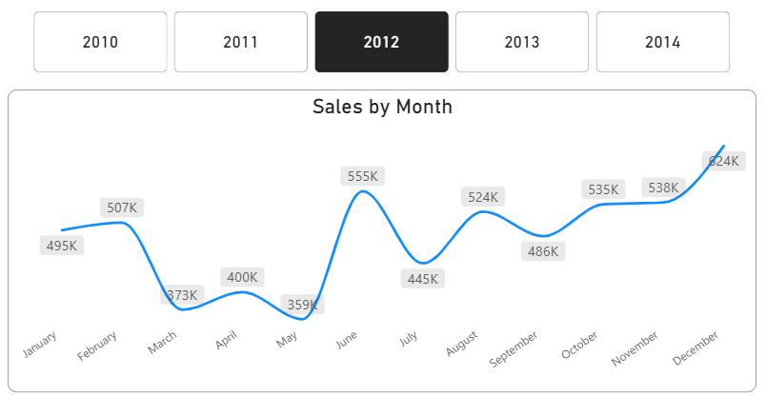
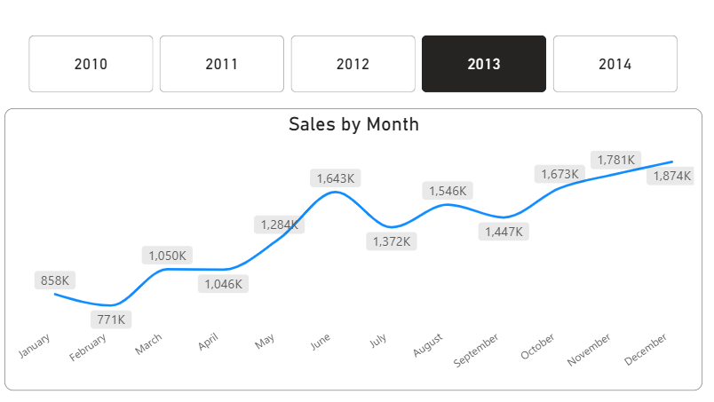
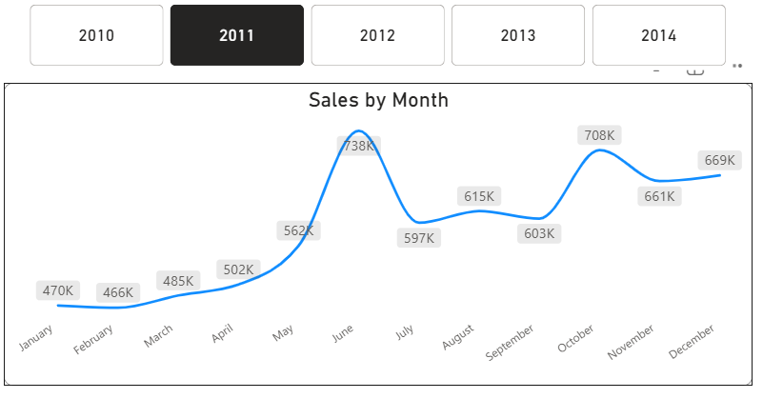
Sales by Month
Overall Growth: Sales increased annually, from 470K (Jan 2011) to 1,874K (Dec 2013), showing a strong upward trend.
Seasonal Peaks: June and December consistently saw the highest sales (e.g., 738K in Jun 2011, 1,874K in Dec 2013), likely due to seasonal demand or promotions.

Slide 10
February and March often had dips (e.g., 373K in Mar 2012), possibly from post-holiday slumps.
Sales fluctuated but recovered well after dips (e.g., 738K in Jun 2011 to 597K in Jul, then 708K in Sep).
March 2012 dropped to 373K, while Dec 2013 surged to 1,874K (127% increase from Dec 2012).

Slide 11
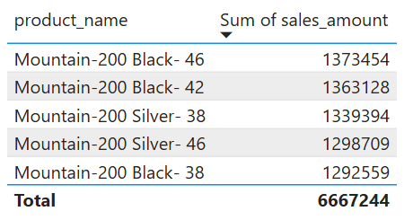
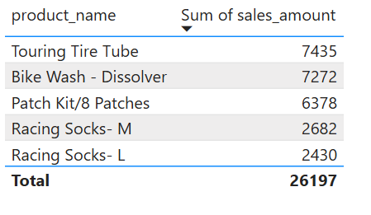
Top & Bottom Performing Products
Top Performing Products (by Sales Amount):
All top 5 products are Mountain-200 bike variants (Black/Silver, sizes 38–46)
Combined, they generated over $6.66M in revenue
This suggests strong demand for high-end mountain bikes, especially size 42–46
Bottom Performing Products:
The lowest performers include Touring Tire Tubes, Bike Wash, Patch Kits, and Racing Socks
Together, they contributed less than $26.2K, indicating low traction or poor visibility

Slide 12
Recommendations Summary Based on our analysis of sales, products, customers, and time trends, here are our key recommendations to drive growth and operational efficiency:
1. Diversify Product Portfolio to Reduce Risk
While the Bikes category contributes 96% of total sales, this over-reliance poses a significant business risk. If market demand shifts, supply issues arise, or competition increases, the impact could be severe.
Invest in growing Accessories and Clothing through product innovation, better positioning, and targeted promotions.
Explore customer bundle behavior to understand what complementary products can be cross-sold or upgraded.
Launch seasonal or trend-based collections to stimulate demand outside core bike sales.
Diversifying revenue streams will stabilize the business and create more resilience in the long term.

Slide 13
2. Prioritize Top Markets
The United States and Australia contribute >60% of total revenue.
Increase targeted advertising, partnerships, and stock availability in these regions.
3. Improve Data Quality
Resolve "n/a" entries in country and product fields (~$230K in sales, 871 items).
Clean, complete data improves analytics, targeting, and reporting accuracy.
4. Plan for Seasonal Peaks
Sales peaked massively in 2013 ($16.35M) after a dip in 2012.
Investigate what drove this growth (e.g., campaigns, launches) and replicate the strategy during future seasons.
5. Boost Cross-Selling Opportunities
Low accessory and clothing sales suggest missed cross-sell potential.
Promote kits, bundles, or checkout suggestions to raise accessory sales per order.

